Slide 1
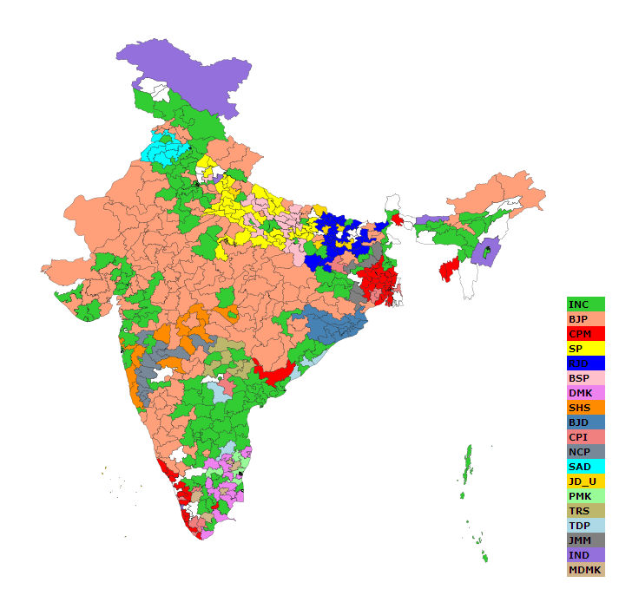
DATA ANALYSIS OF GENERAL ELECTION OF PARLIAMENTARY / ASSEMBLY CONSTITUENCIES:TRENDS & RESULTS- 2024
SASANKA.P

Slide 2
10 INSIGHTS FROM THE DATA SET.
STATE THE VOTE COUNT & VOTE SHARE IN PARLIAMENTARY CONSTITUENCY GENERAL.
ANALYSE THE ELECTIONS IN ANDHRA PRADESH VIA COMPARING MLA&MP SEATS.
STATE THE TOP% OF CANDIATES VIA MARGIN (MLA&MP) IN AP.
ANALYSE THE ELECTIONS IN ODISHA VIA COMPARING MLA&MP SEATS.
STATE THE TOP% OF CANDIATES VIA MARGIN (MLA&MP) IN ODISHA.
ANALYSE THE ELECTIONS IN ARUNACHAL PRADESH VIA COMPARING MLA&MP SEATS.
STATE THE TOP% OF CANDIATES VIA MARGIN (MLA&MP) IN ARUNACHAL PRADESH.

Slide 3
ANALYSE THE ELECTIONS IN SIKKIM VIA COMPARING MLA&MP SEATS.
STATE THE TOP% OF CANDIATES VIA MARGIN (MLA&MP) IN SIKKIM.
INSIGHTS ABOUT BY-ELECTIONS IN 2024.

Slide 4
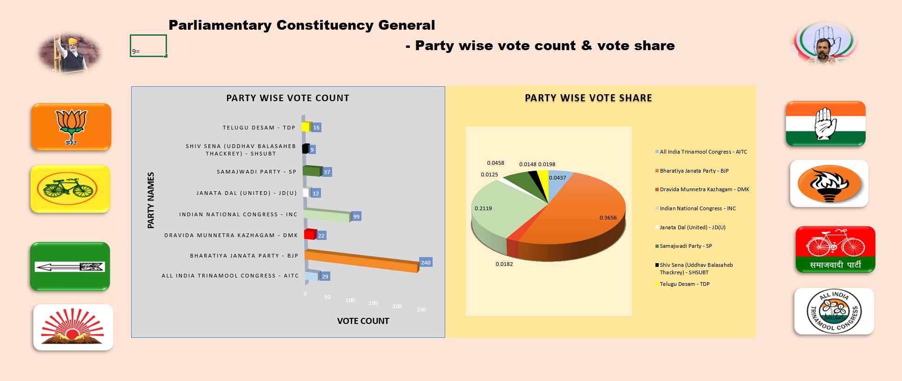

Slide 5
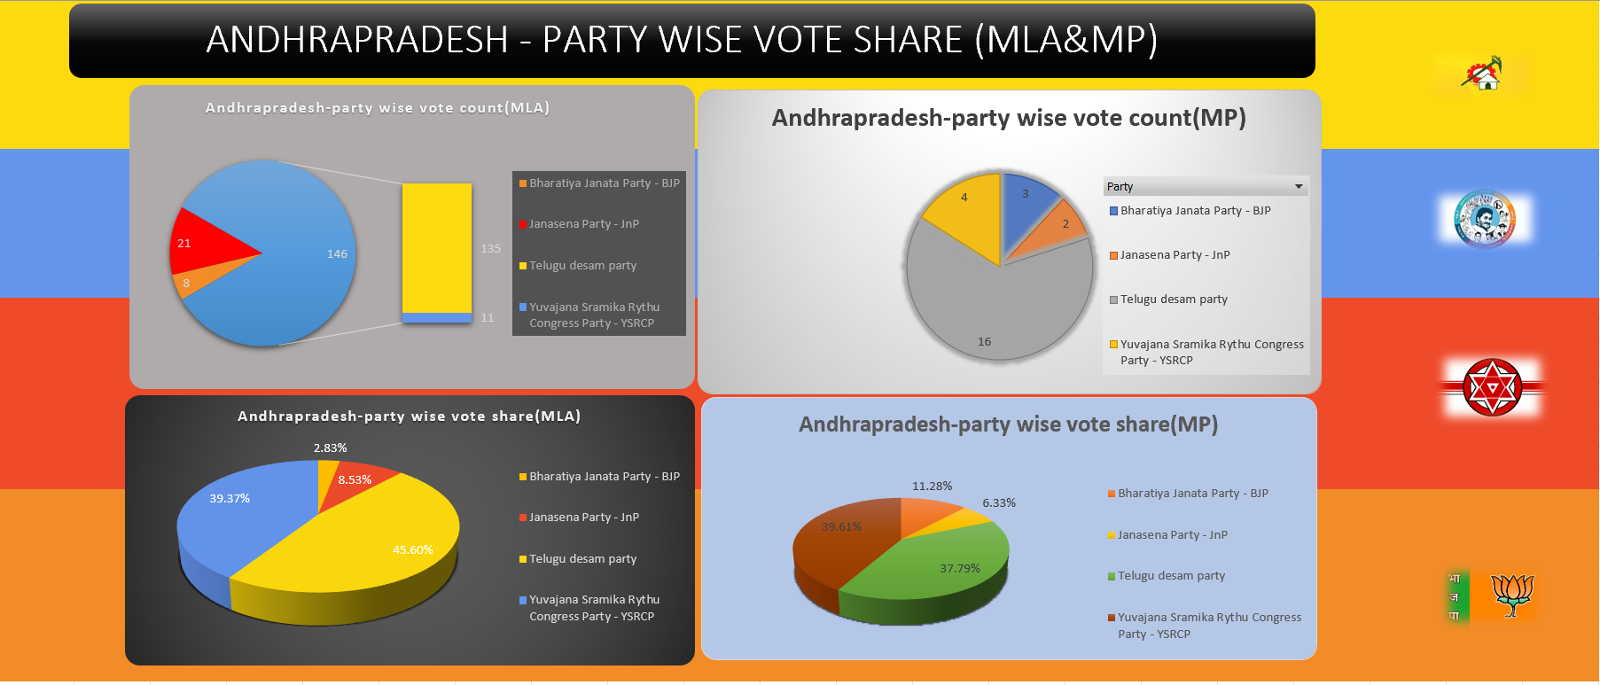

Slide 6
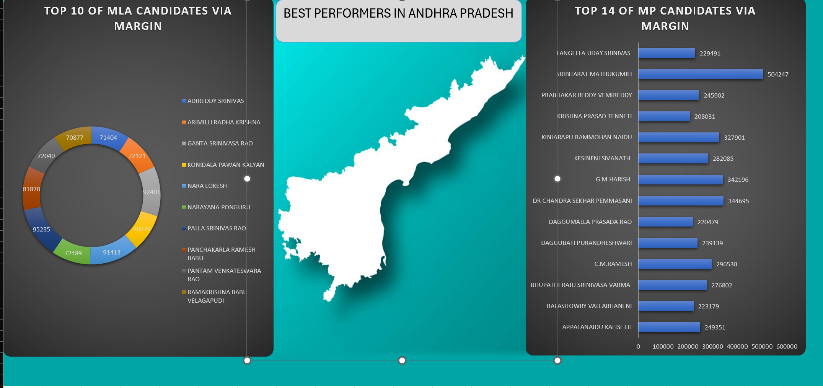

Slide 7
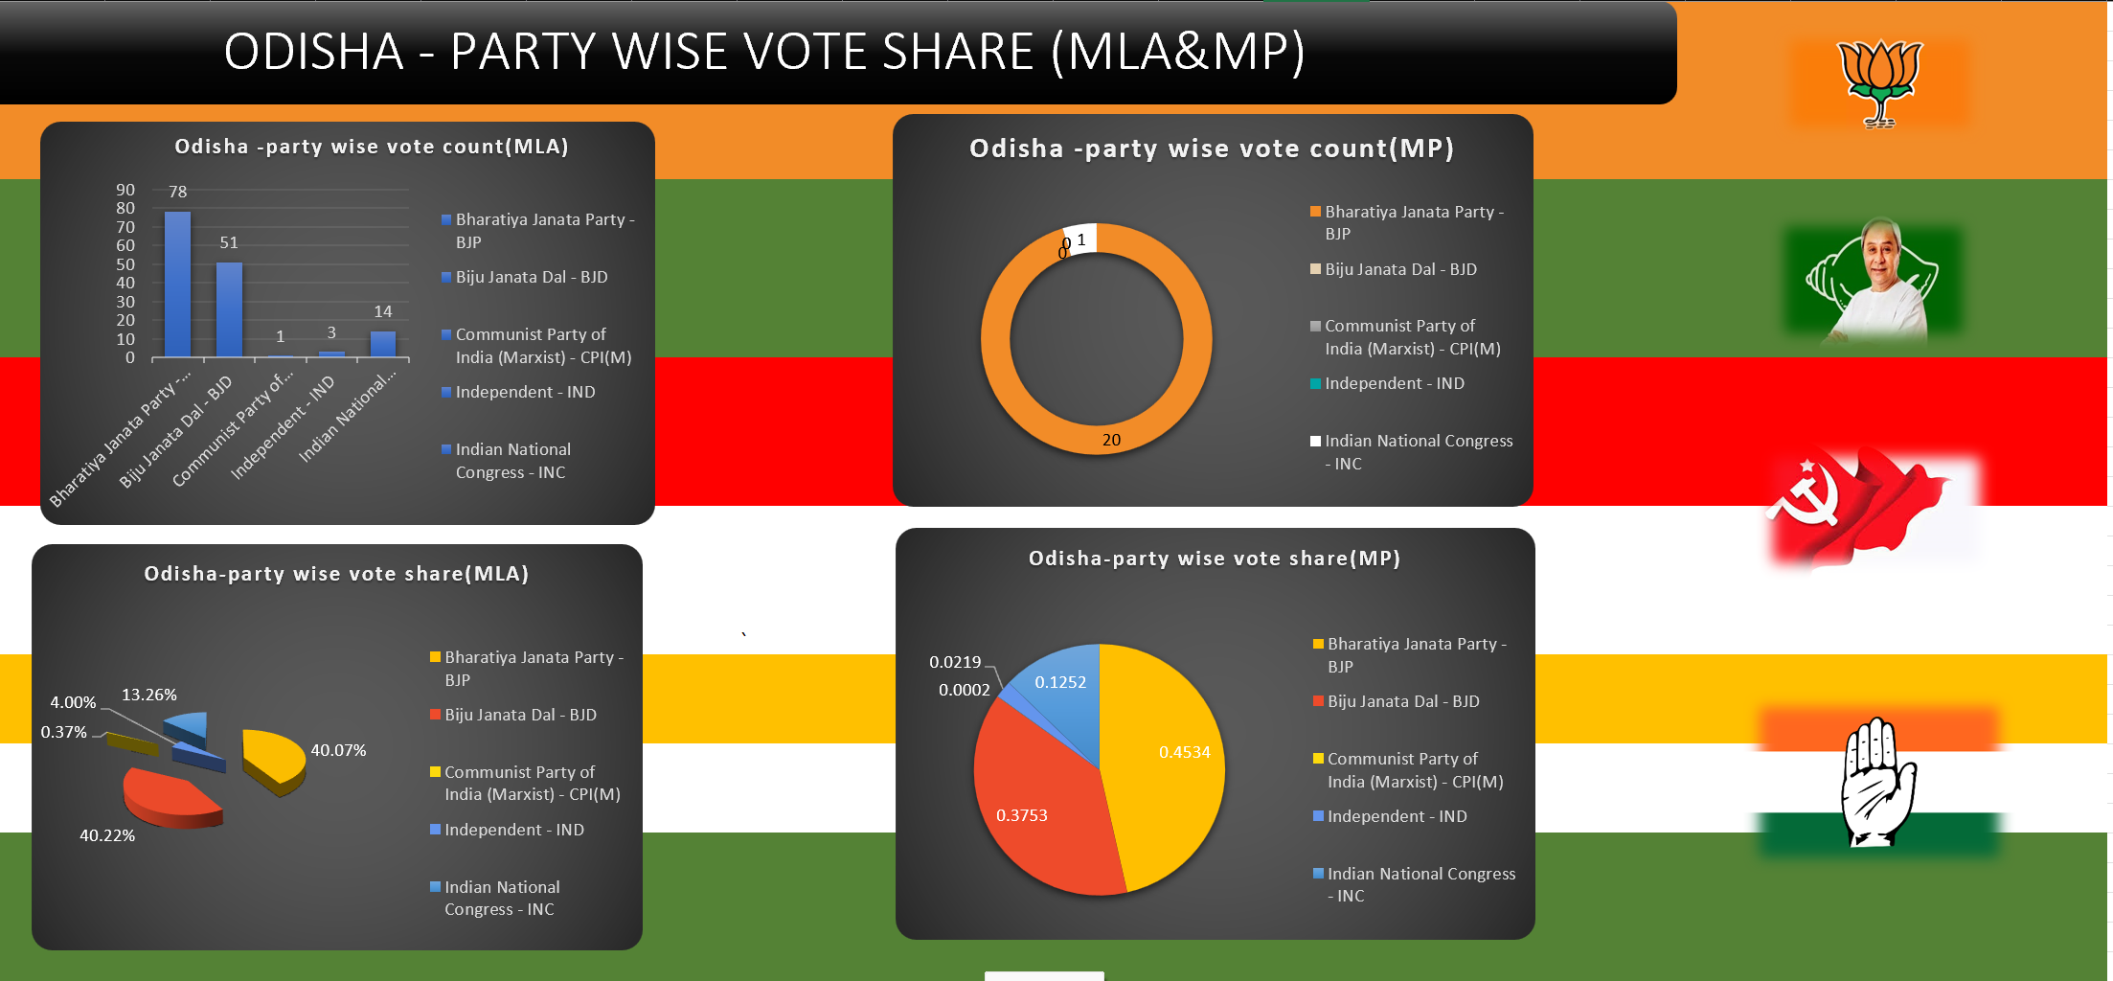

Slide 8
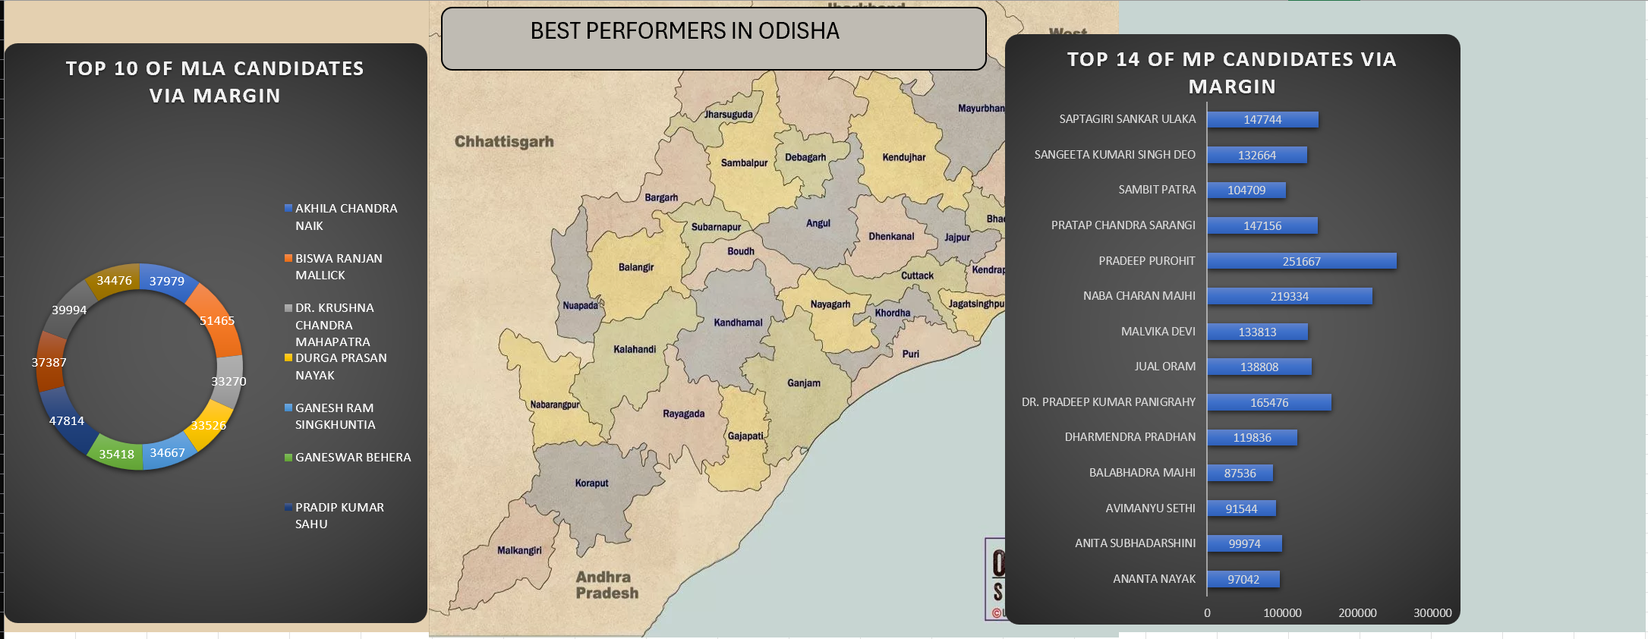

Slide 9
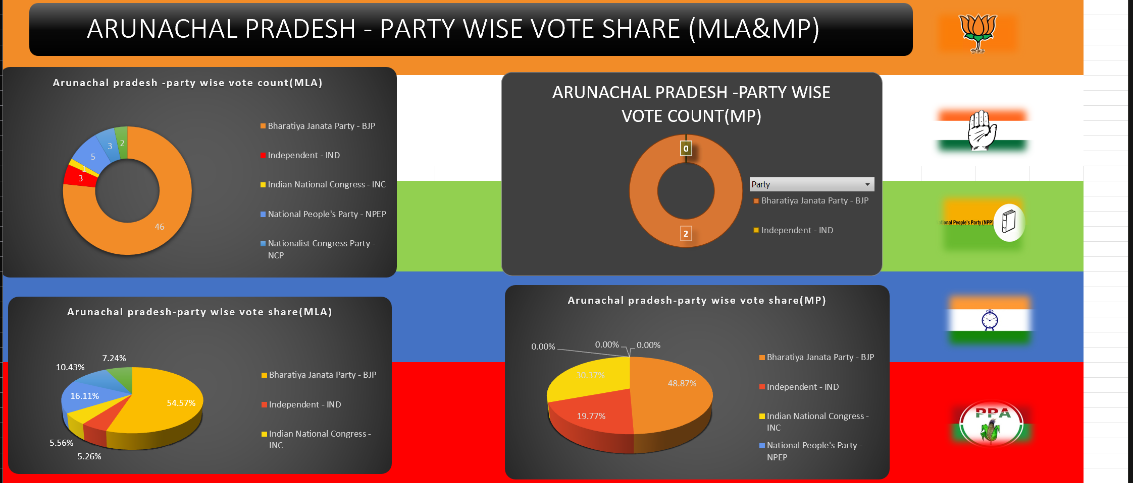

Slide 10
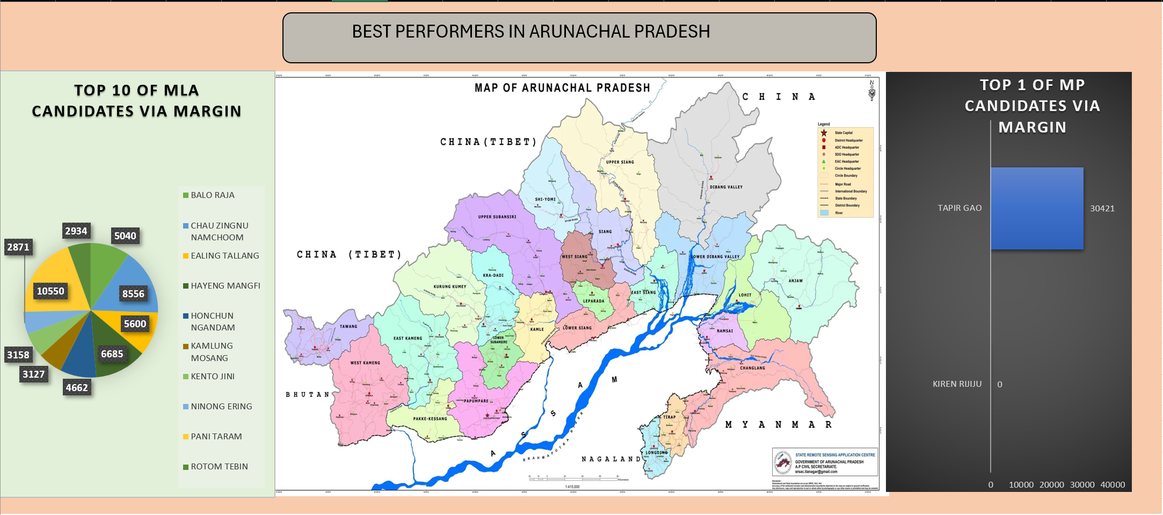

Slide 11
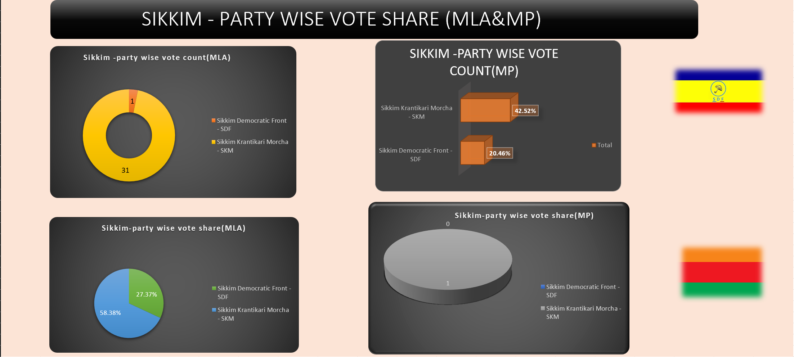

Slide 12
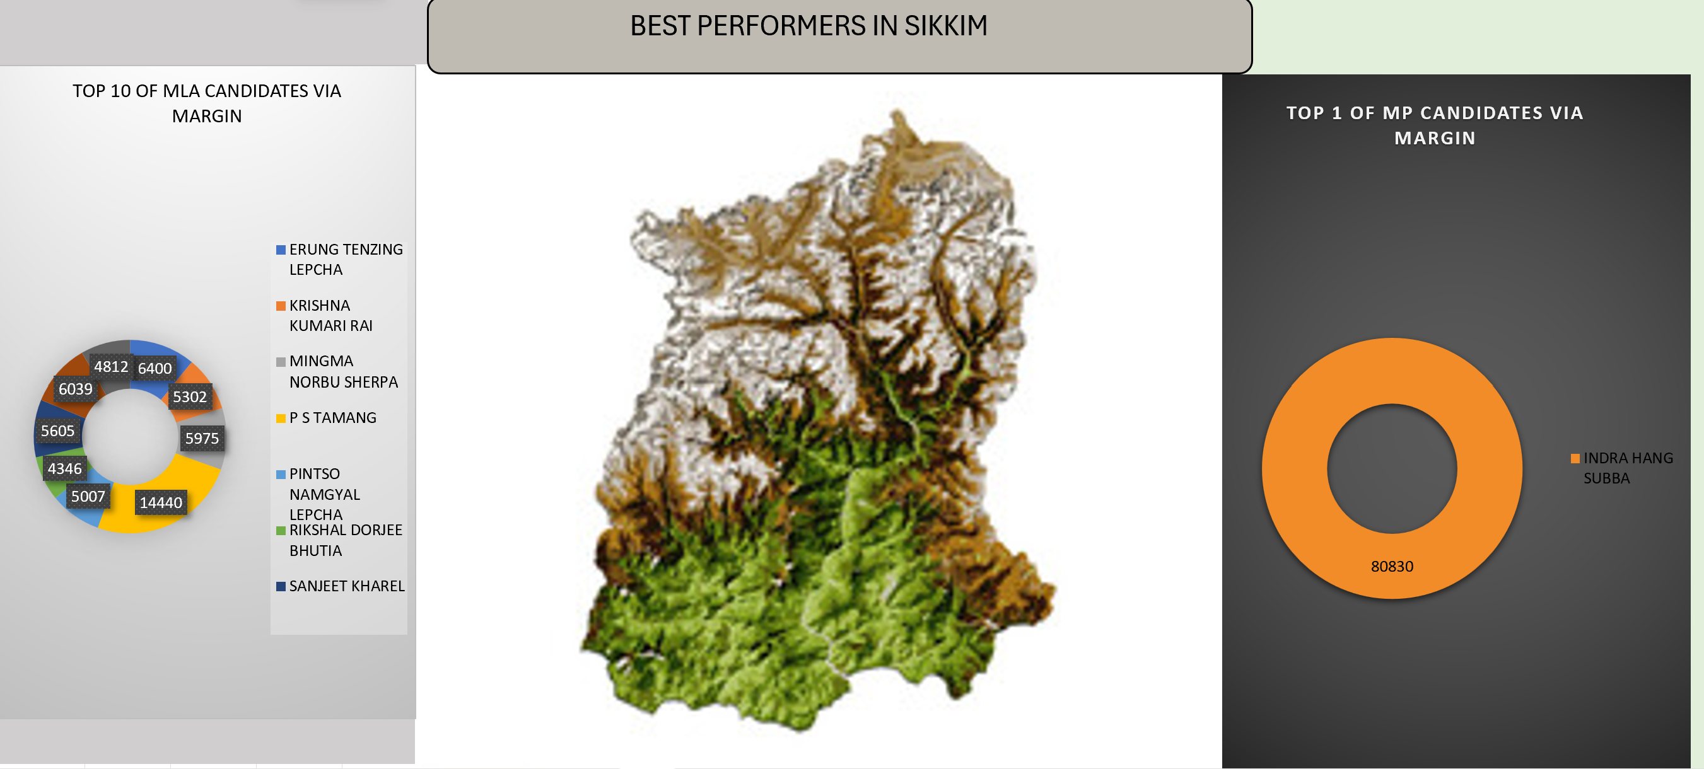
9.STATE THE TOP% OF CANDIATES VIA MARGIN (MLA&MP) IN SIKKIM.

Slide 13
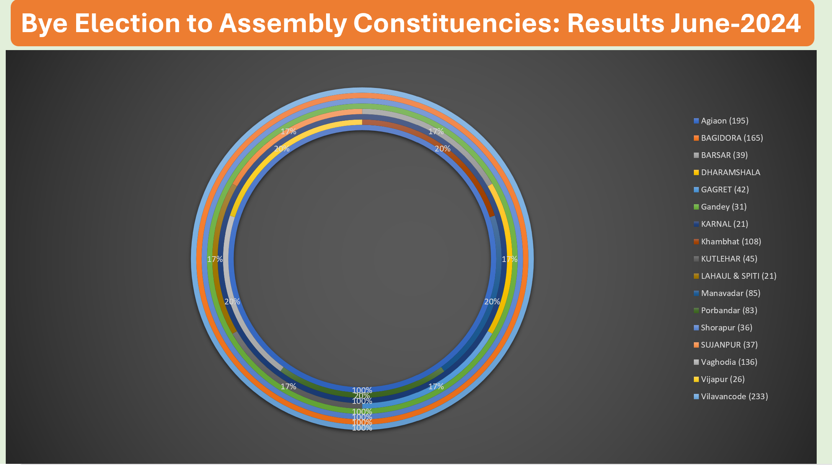
10. INSIGHTS ABOUT BY-ELECTIONS IN 2024.

